Slide 1
Proposed NXP Contribution to NEMF21 Project
NEMF21 Kick-Off Meeting
Sidina Wane
NXP- Semiconductors
Nottingham 4 July 2015

Slide 2
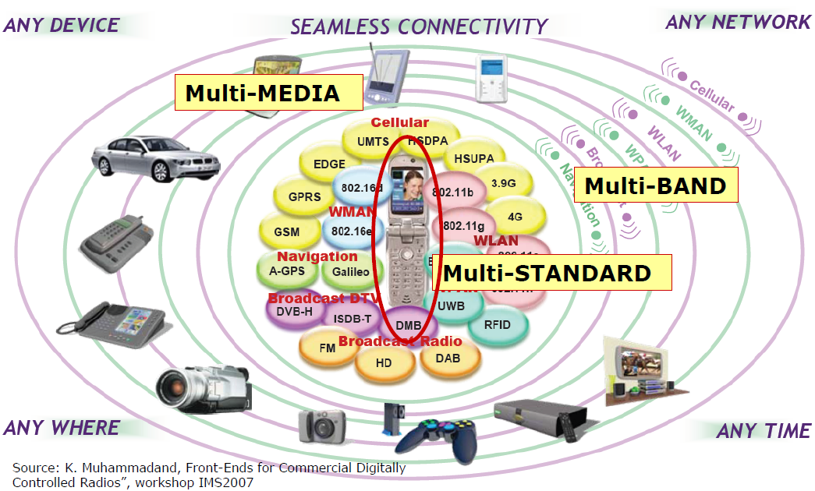
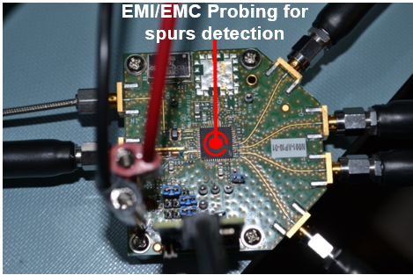
NXP Interest towards IoT
NEMF21 as a Noisy-Electro-Magnetic-Field aware Technological Platform for 5G applications addressing the challenge: “Any-Device”, “Any-Network”, “Any-Where”, “Any-Time” with “Seamless Connectivity”.
NXP envision Chip-Package-PCB [including antennas] Co-Design methodologies to ensure First Time Right in the realization of 5G wireless links between systems including circuits operating as Multiple-Input Multiple-Output devices.
Any-Device
SEAMLESS
CONNECTIVITY
Any-Network
Near-Fields measurement
of radiated stochastic EM fields
Any-Where
Any-Time
«Unifying» Measurement & Modeling

Slide 3
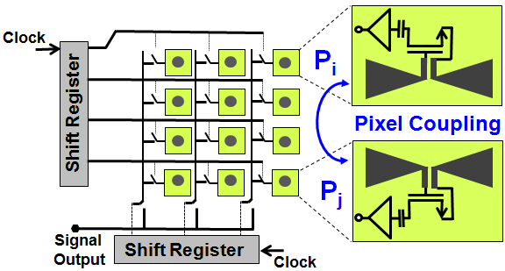
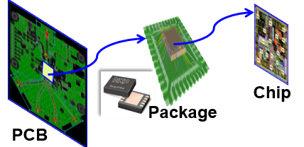
Chip-Package-PCB Co-Design & Co-Verification
ITRS Technology Roadmap for Semiconductors
NXP
Qubic4Xi
Transit Frequency (in GHz)
Chip-Package-PCB
Co-Design
Trend
Year
Advanced integrated circuits in the Sub-millimeter or THz domain suffer from two main limitations: power generation-transport (actives and passives) and efficient radiation (antennas).
Necessity of innovative Co-Design and Co-Verification methodologies.

Slide 4

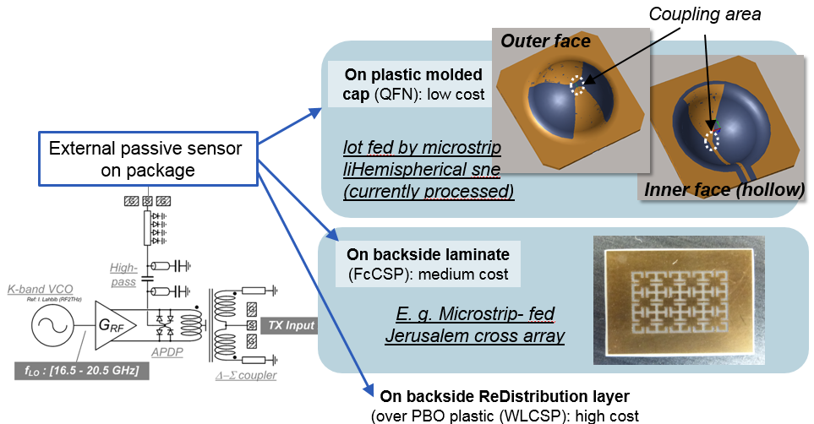
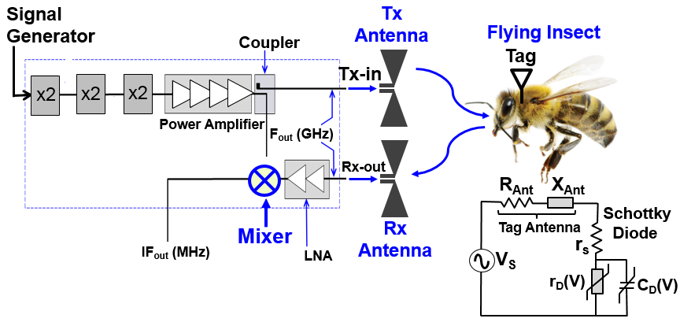
Ongoing Studies
3D Packaging & Moving Objects
Use of 3D packaging solutions for Development of dielectric sensor systems, including reflectometry circuits in mm-Wave domain.
Qualification of Harmonic radar systems using Sub-Harmonic mixers and on-package antennas for tracking tagged flying objects
reflectometry in mm-Wave domain
Including 3D packaging solutions
Harmonic radar for tracking moving objects
(tagged flying insects)

Slide 5
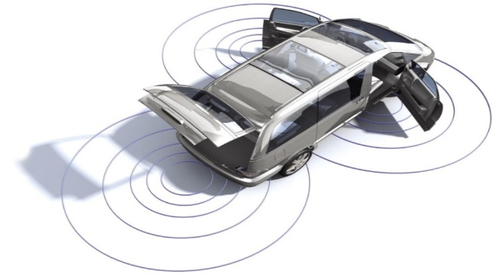
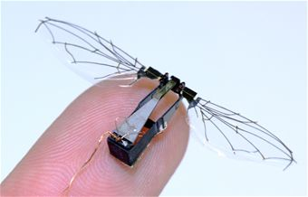
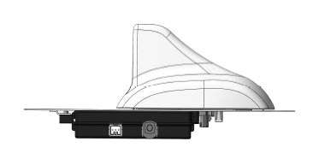
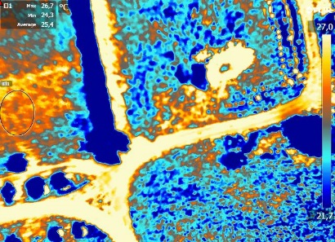

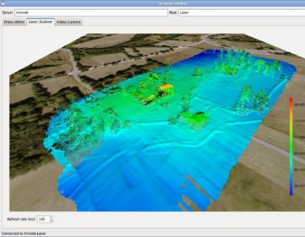
Ongoing Studies
Power-Signal Integrity, EMC/EMI of Moving Objects
Towards Autonomous Moving targets
Towards Autonomous Nanodrone
Car2X
DSSS
2-way
Diagonis & detection of Pollution
Archeology
Under-water applications
J.M. Moschetta, « Innovative design of mini-UAV configurations : key challenges and technical breakthroughs », ANACOM 8ème congres URSI-Portugal, Lisbonne, Nov 2014.
D. Bajon « Micro & Nano aerial vehicules : New perspectives and Opportunities for RF design», ANACOM 8ème congres URSI Portugal, Nov 2014.
P. Russer, J. A. Russer, F. Mukhtar, P. Lugli, S. Wane, D. Bajon, W. Porod, “Integrated Antennas for RF Sensing, Wireless Communications and Energy Harvesting Applications”, 2013 International Workshop on Antenna Technology.

Slide 6
Suggested Main Task & Interactions
Area of Primary Contribution
HARDWARE MANUACTURING: Technological realization of monolithically integrated antennas and integrated circuits for Chip-to-Chip communications. Both two-port and multi-port (MIMO) wireless links will be jointly proposed with NEMF21 partners.
BENCHMARKS SYSTEMS: Proposal of system-level carriers (single chip and multi-chip [module] applications) for measurement, characterization and analysis of radiated stochastic fields. Based on these measurements the radiated field distributions in system scenarios will be modeled.
ADVANCED DESIGN PROPOSALS: Design solutions for feasibility study of innovative packaging solutions to enable breakthrough in non-contact Chip-to-Chip communication systems
Identified Main Interactions
Collaboration with NEMF21 partners for Near-Fields measurement of radiated stochastic EM fields.
Collaboration with NEMF21 partners for antenna measurement and characterization possibilities in time and frequency domains including evaluation of radiation efficiency
Collaboration with NEMF21 partners on software, signal processing, numerical methods for noisy EM fields
WP3
WP1
3D View of Built Package Model for AERO4231
WP4
Resource Allocation
1 experienced engineer working on design and verification activities for a period of 3 years
1 experienced engineer working on circuit & system benchmarks for a period of 3 years

