Slide 1
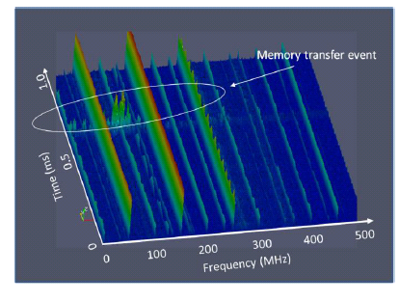
The George Green Institute for Electromagnetics Research (GGIEMR)
Proposed Work programme

Slide 2
Support development, demonstration and validation via a measurement program based on a scaled frequency scenario
Allows a well controlled and readily quantifiable measurement system
The scaled systems will be flexible and easy to reconfigure making use of existing EM measurement facilities at UoN
enable representative data to be delivered to partners

Slide 3
characterisation of the electromagnetic environment in and around representative systems
the investigation and demonstration of communication technologies suitable for chip to chip and on chip communications in realistic, complex and noisy EM environments.

Slide 4
EM Measurement
Noisy near field electromagnetic environment measurements will be based on the near field scanning technique (time and frequency).
Techniques to enhance the viability (measurement time) of these techniques using antenna arrays will be developed.
variety of representative configurations including confined complex sources with multiple reflections and scattering of the field. The sources will be based on highly populated PCBs with complex behaviour providing representative and well understood results

Slide 5
Communications demonstrator
investigating candidate systems for chip to chip communications, again in a scaled scenario using PCB scale devices.
propose to use software defined radio kits to investigate communications protocols in a variety of prototypical situations to give a great deal of flexibility in the study, including allowing the control the beam pattern within the limits of the number of antennas available.
Tests will include anechoic chamber, mode stirred chamber, communications in small enclosures as well as all of the above in the presence of noise

Slide 6
Institute’s Facilities

Slide 7
Computational Facilities:
PC to HPC:
Multicore (CPU) and manycore (GPU) platforms
Heterogenous computing.
Local clustered facilities:
2 x 10 compute node (92 core), 320GB RAM, Infinband network.
Access to UoN HPC:
166 compute nodes (>2,500 cores), >5TB Ram, Infinband network, GPU equipped.
Many man years of software development experience in providing robust software to industrial customers.

Slide 8
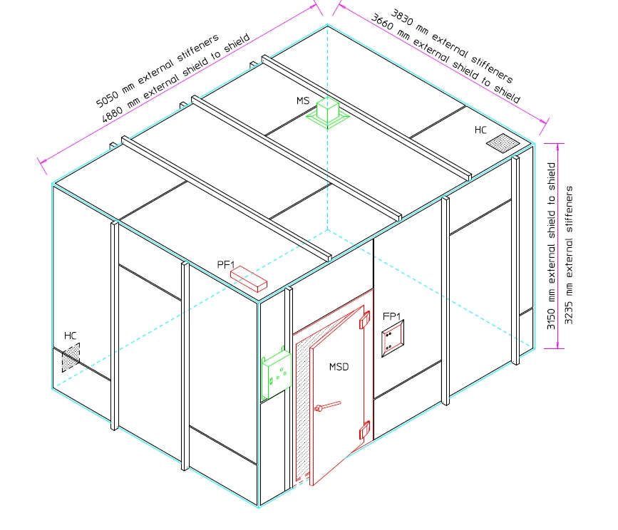
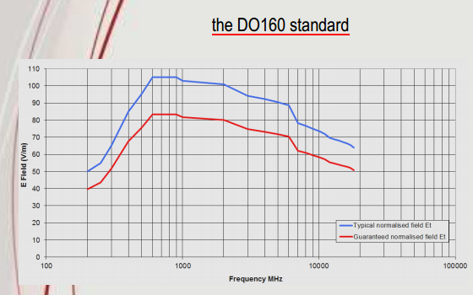
Experimental Facilities:
Mode Stirred Chamber:
200MHz – 40GHz
Immunity and emissions testing
EUT ~1m³
High field strengths achievable for modest input power: for 1W input

Slide 9
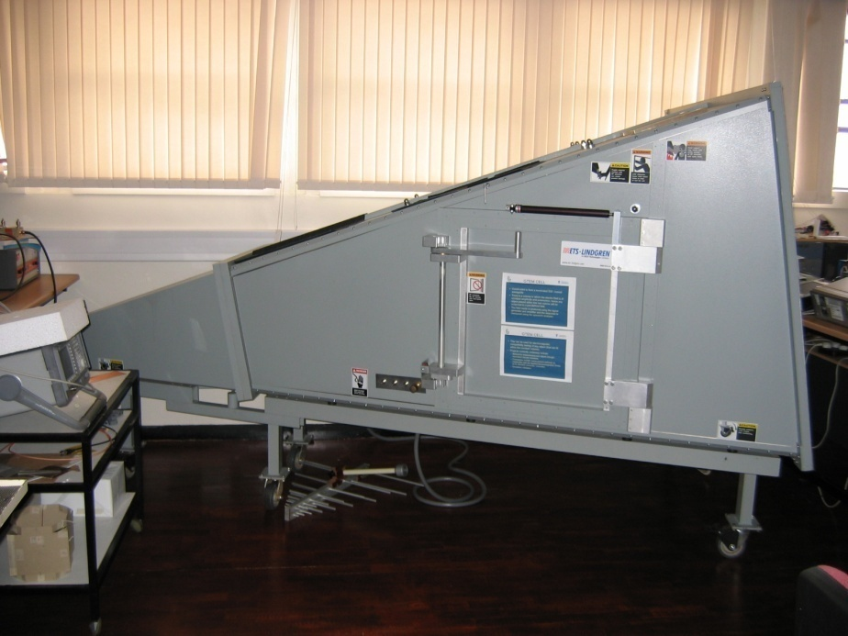
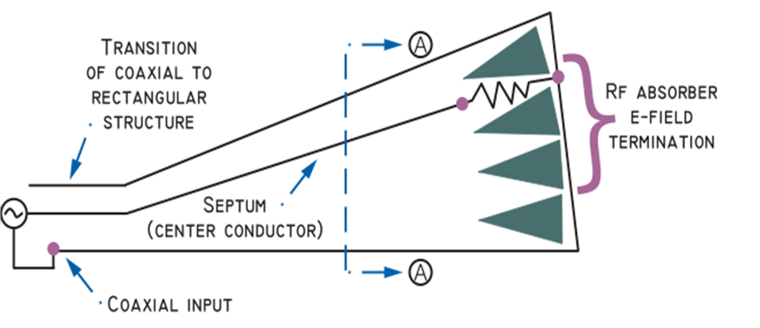
Experimental Facilities:
GTEM Cell:
DC – 20GHz
Immunity and emissions testing
Predictable uniform field
EUT ~ 30cm³

Slide 10
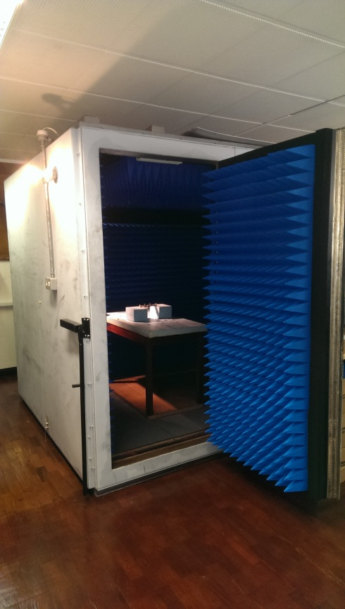
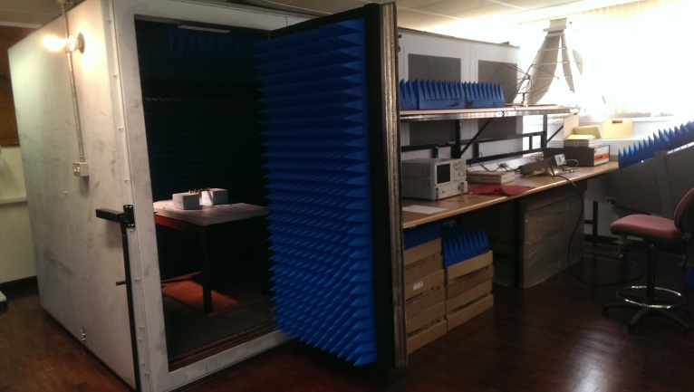
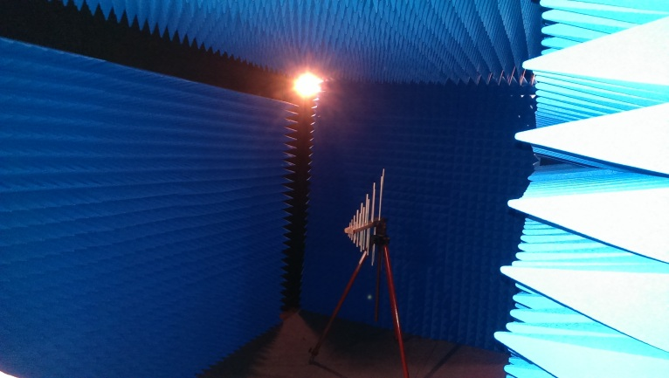
Experimental Facilities:
Anechoic Chamber:
<1GHz – >20GHz

Slide 11
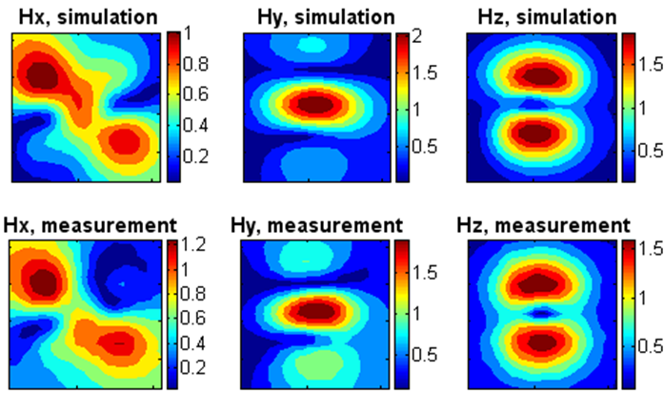
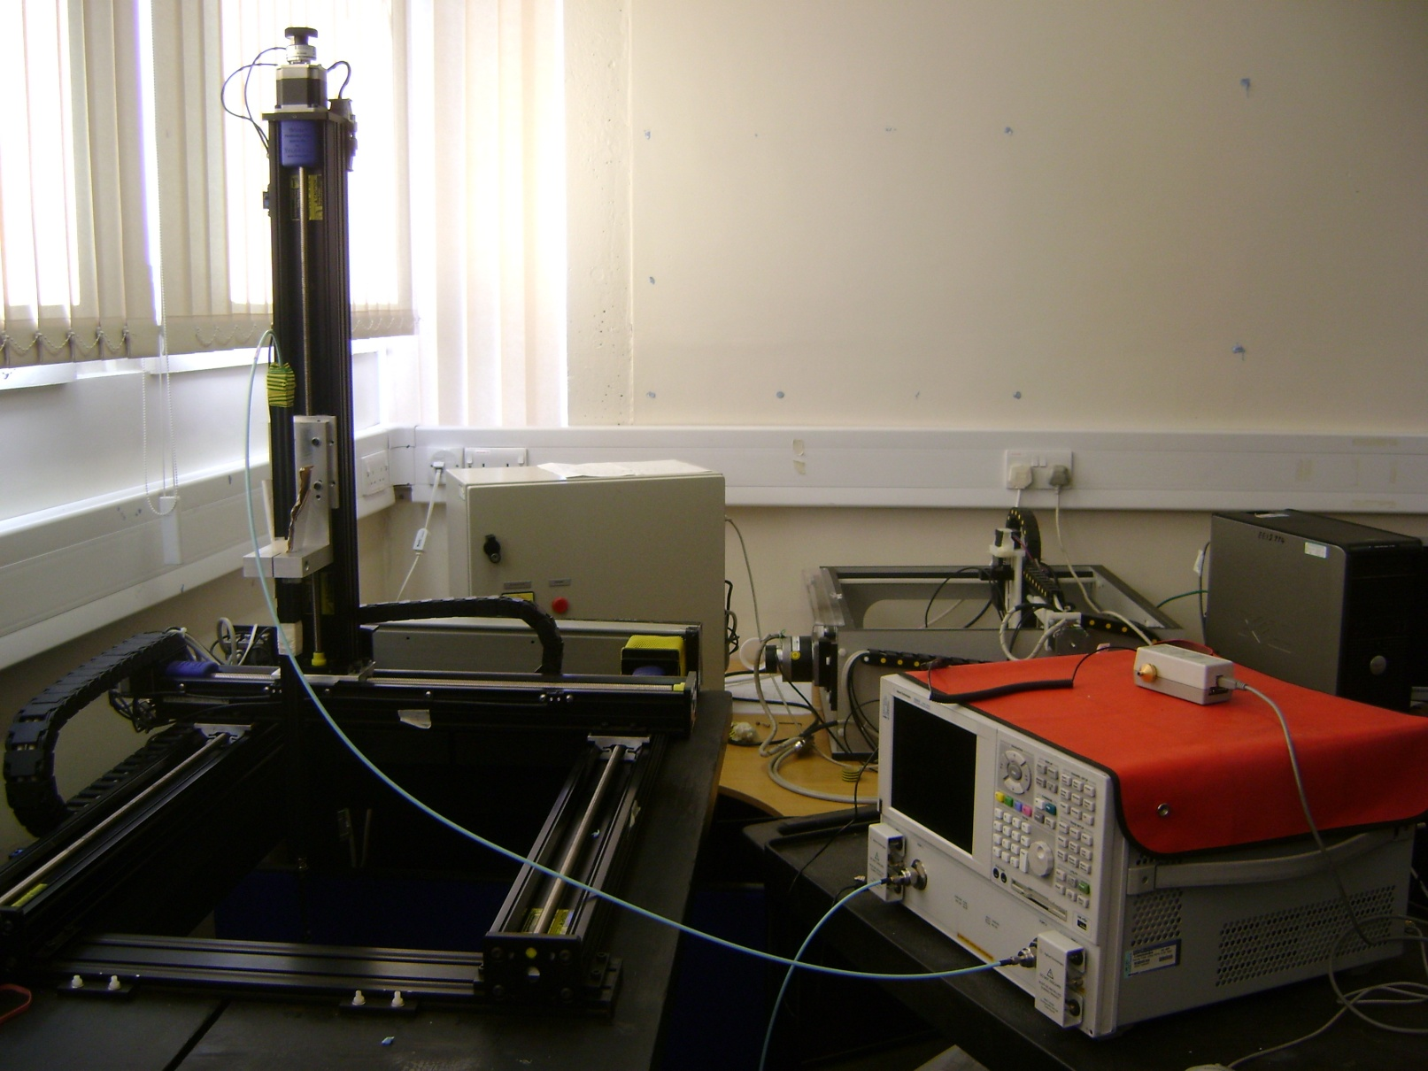
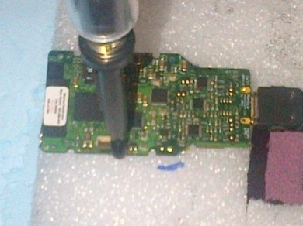
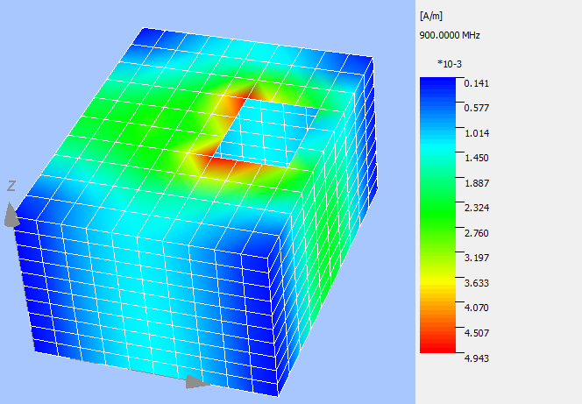
Experimental Facilities:
3D Near field scanner:
Measurement of radiated emissions from complex components.
Measured data readily imported into CEM modelling process as an equivalent radiator.

Slide 12
Equipment requirements
DSOS604A digital oscilloscope: 6Ghz, 20 GSa/s 10-bit (i.e. good low noise performance), 4 channels
£30,559.20 approx. €38,433.77
2×Nutaq Software Defined Radio – PicoSDR: 4 independent TX/RX channels, MIMO upto 4x4, Carrier freq. 300MHz – 3.8GHz, Bandwidth 1.5. to 28MHz
£10,071 approx. €12,661.33 each = €25322.66 total.
Miscellaneous equipment: Various circuit boards to be made with representative antennas to mimic scaled chip-to-chip devices.
approx. €3,000

